Slide 1
Phase transitions of argon
Presentation by Patrick Raaf, Esengül Sevimli, Moritz Ziegler

Slide 2
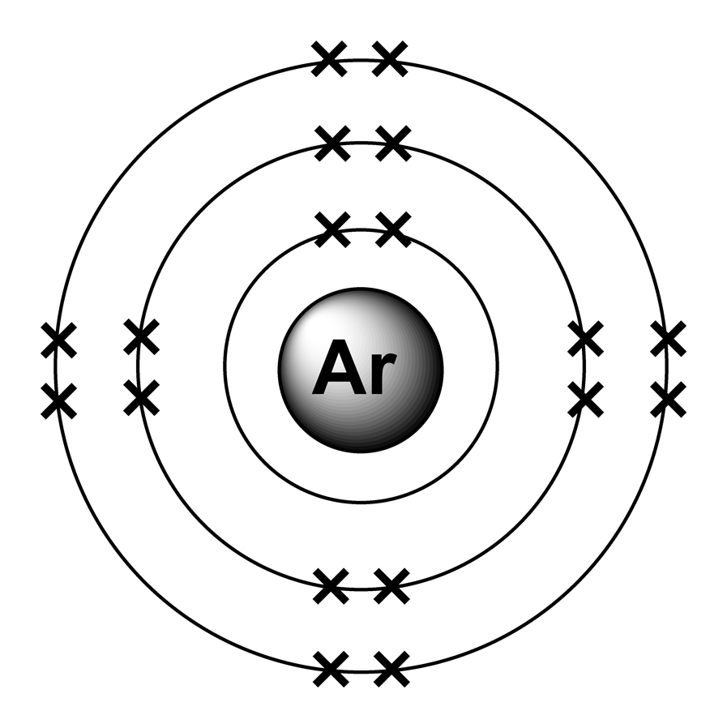
Properties of argon
Atomic number: 18
Atomic mass: 39.948 g/mol
Element, noble gas
High degree of inertness
Mono-atomic (in all phases)
Apolar
Adapted from:
https://sites.google.com/site/ellesmerealevelchemistry/[...]

Slide 3
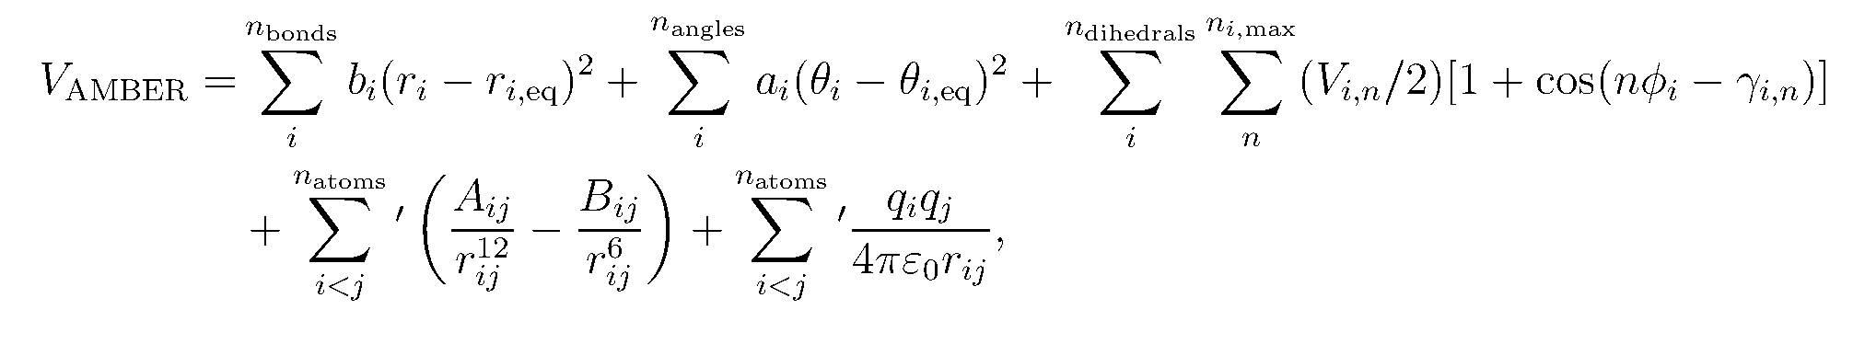
Force field
For example AMBER:
Bonds
Angle bends
Torsion
Coloumb Potential
Pauli repulsion + Van-der-Waals attraction
Adapted from: http://ambermd.org/tutorials/basic/tutorial0/

Slide 4
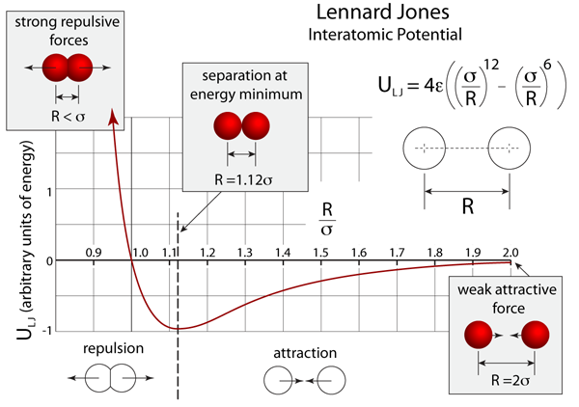
Lennard-Jones potential (ULJ)
Adapted from: http://atomsinmotion.com/book/chapter5/md
Free moving atoms are weakly attracted to each other at long range R and strongly repulsed at short range R (below the van-der Waals radii σ).

Slide 5
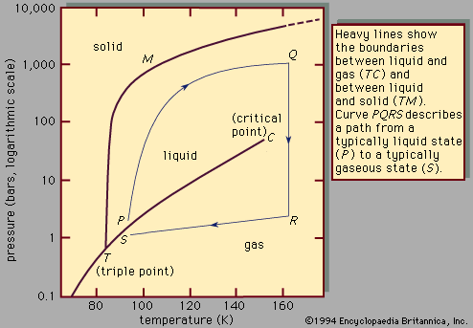
Experimental phase diagram of argon
Triple point of Argon: 83.8058 K, ​0.6889 bar
Melting point at 1 bar: 83.81 K ​(−189.34 °C)
Boiling point at 1 bar: 87.302 K ​(−185.848 °C)
Adapted from http://cmb.bio.uni-goettingen.de/pract/p1/

Slide 6
Goal
Simulating phase transitions and compare the findings to the experimental phase diagram.
Tutorial at http://cmb.bio.uni-goettingen.de/pract/p1/

Slide 7
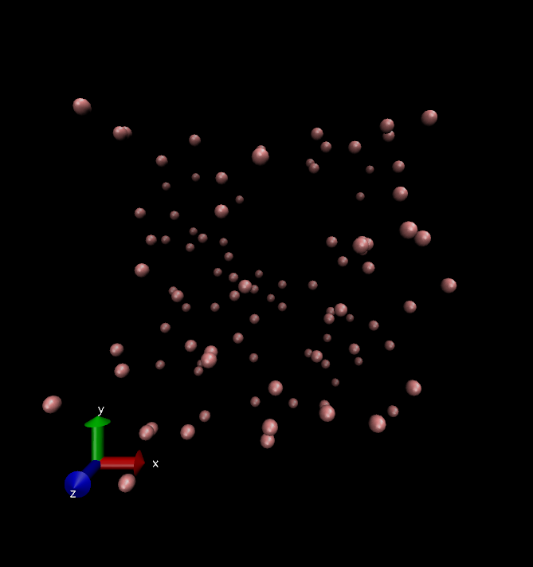
MD simulations
NVT ensemble:
Gaseous argon (100k)
Cooling from gas (100 K) to solid (25 K)
Heating from liquid (25 K) to gas (100 K)
atom distances (radial distribution)
Freezing from liquid (100 K) to solid (0 K)
NPT ensemble:
Cooling from gas (100 K) to solid (25 K)
Initial configuration for all MDs

Slide 8
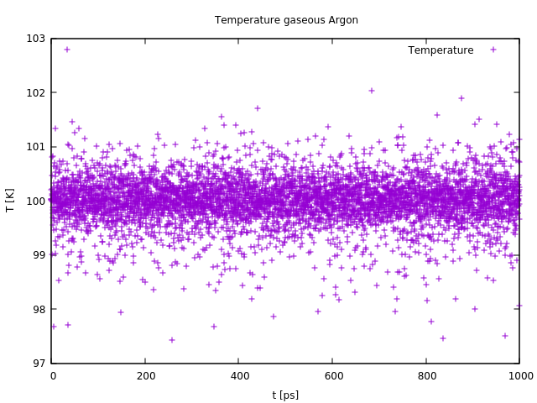
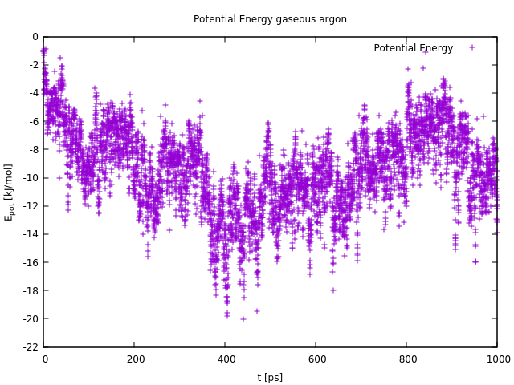
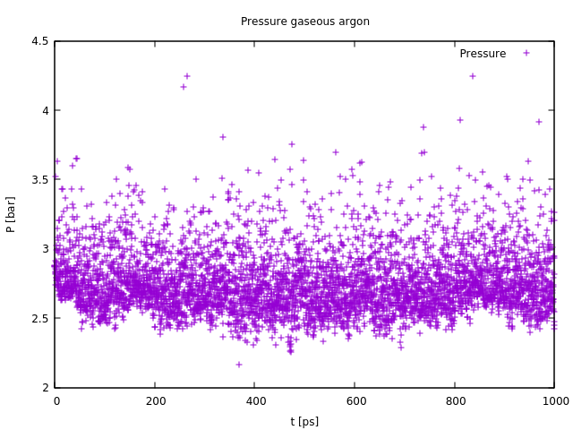
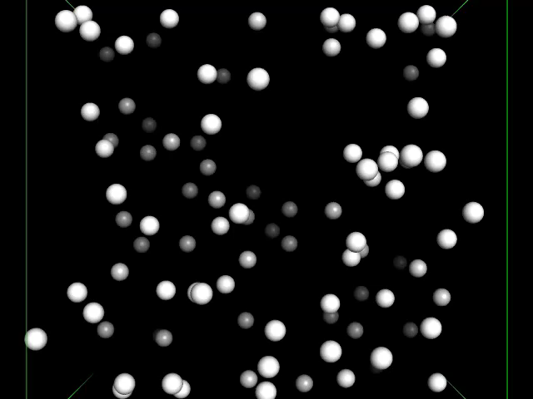
Gaseous argon
Conditions:
100 K,
100 particles/729 nm3,
1000 ps,
500 steps/ps

Slide 9
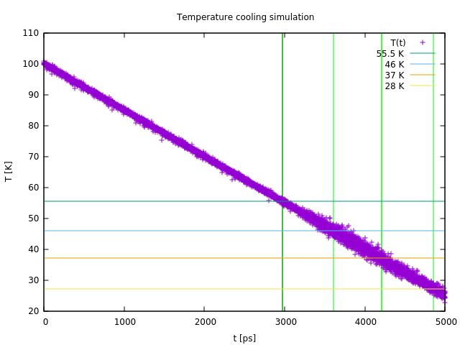
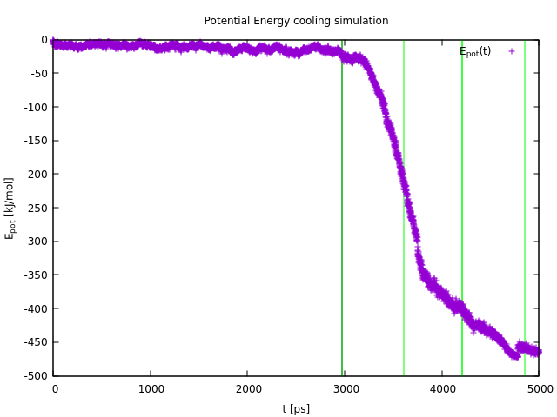
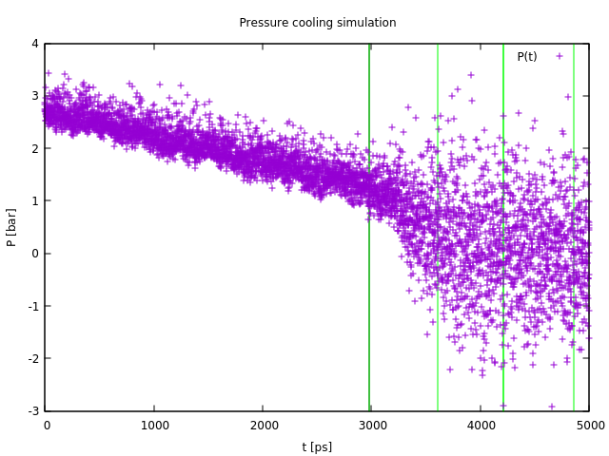
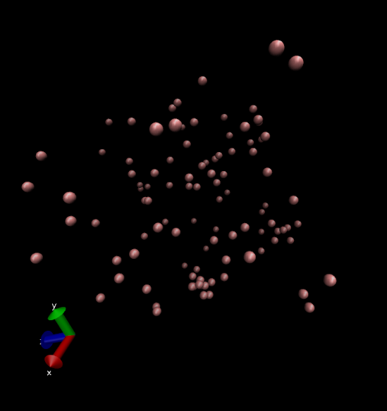
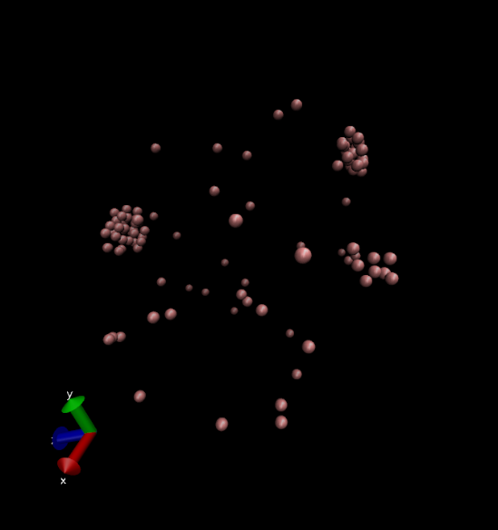
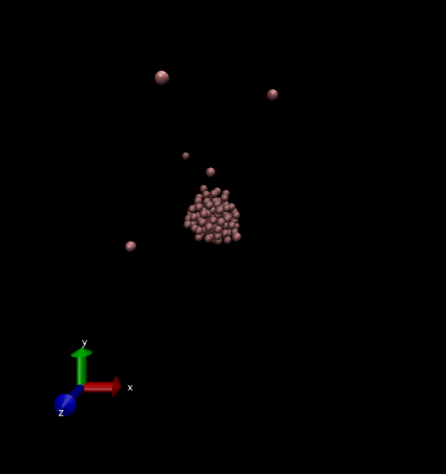
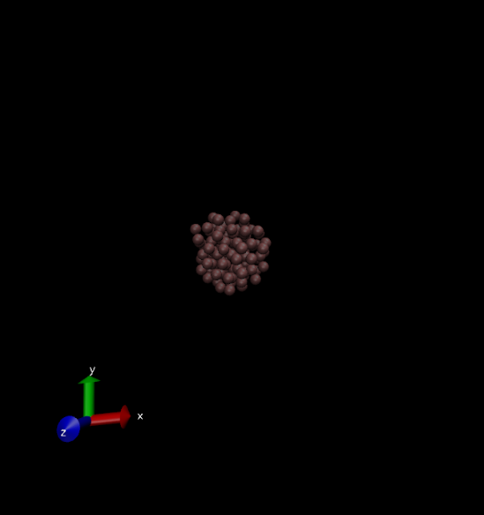
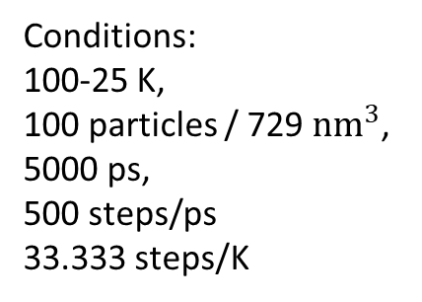
Cooling
boiling point (46K)
melting point (28K)
Conditions:
100-25 K,
100 particles / 729 ${nm}^{3}$,
5000 ps,
500 steps/ps
33.333 steps/K
55.5 K
46 K
37 K
28 K

Slide 10
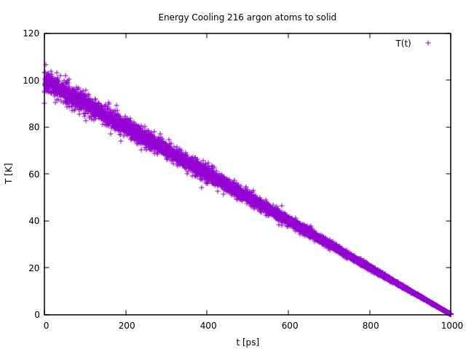
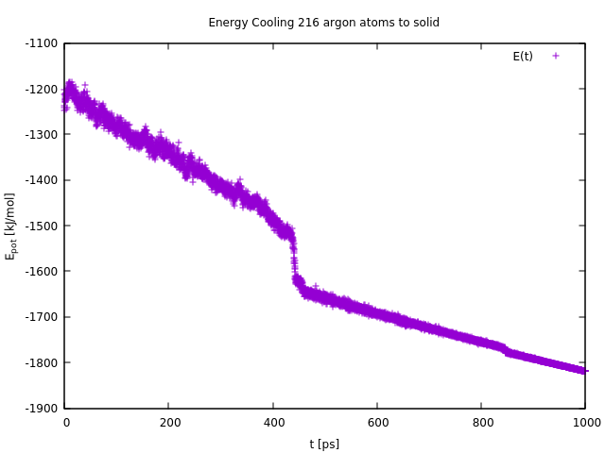
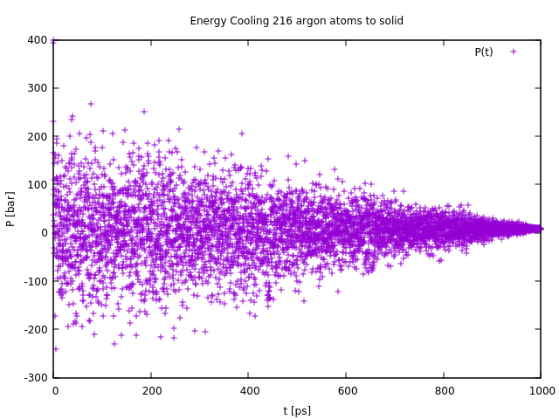
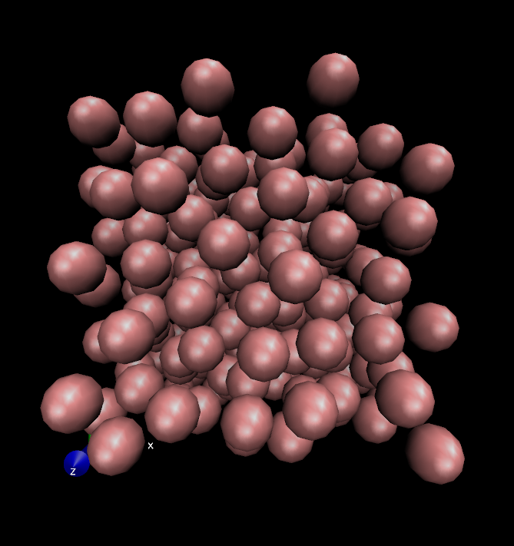
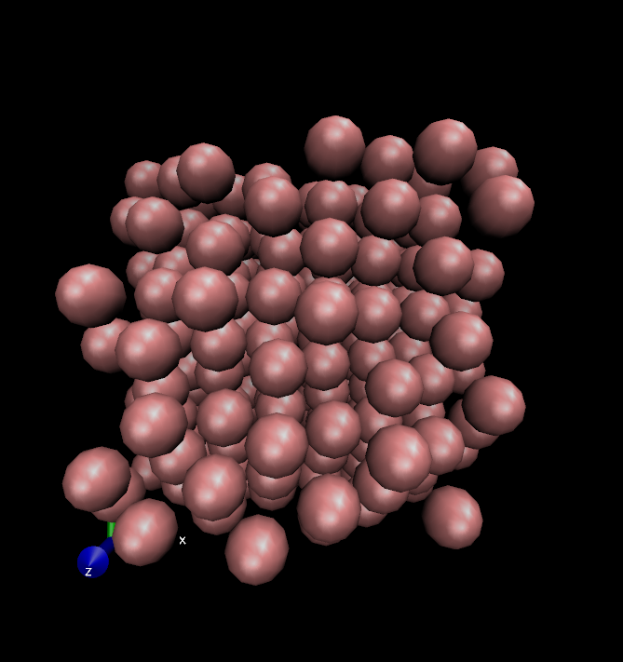
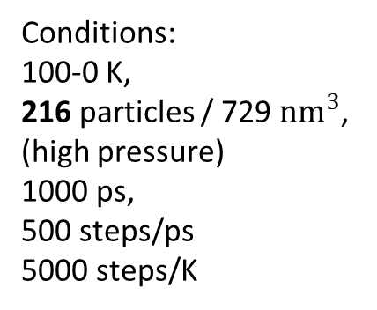
Freezing
Conditions:
100-0 K,
216particles / 729 ${nm}^{3}$,
(high pressure)
1000 ps,
500 steps/ps
5000 steps/K
76 K
53 K

Slide 11
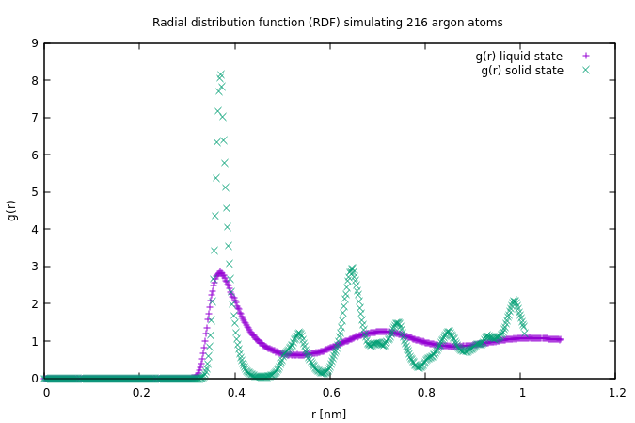
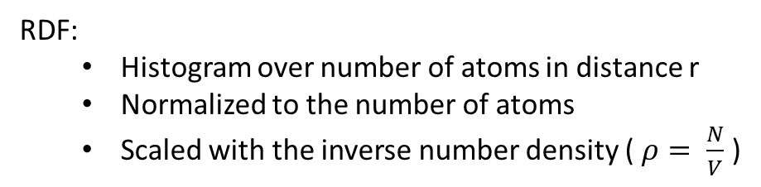
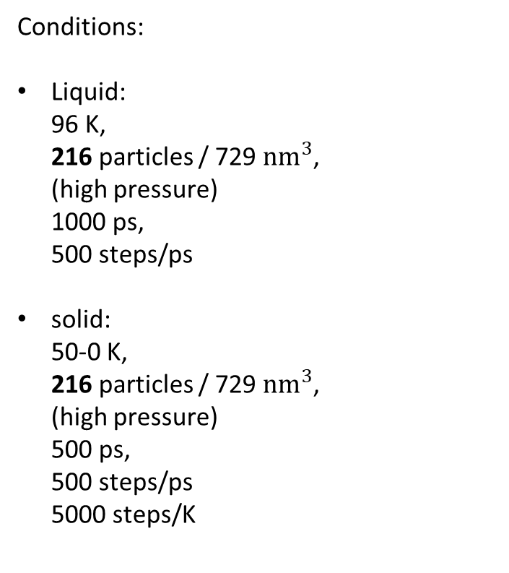
Radial distribution functions (RDF)
Conditions:
Liquid: 96 K, 216particles / 729 ${nm}^{3}$, (high pressure) 1000 ps, 500 steps/ps
solid: 50-0 K, 216particles / 729 ${nm}^{3}$, (high pressure) 500 ps, 500 steps/ps 5000 steps/K
RDF:
Histogramovernumberofatoms in distance r
Normalizedtothenumberofatoms
Scaledwiththe inverse numberdensity( $ρ= \frac{N}{V}$ )
Notes:
Diffusion constant: 2.59 $∗{10}^{−5}\frac{{cm}^{2}}{s}$
Experimental: 2.43$∗{10}^{−5}\frac{{cm}^{2}}{s}$

Slide 12
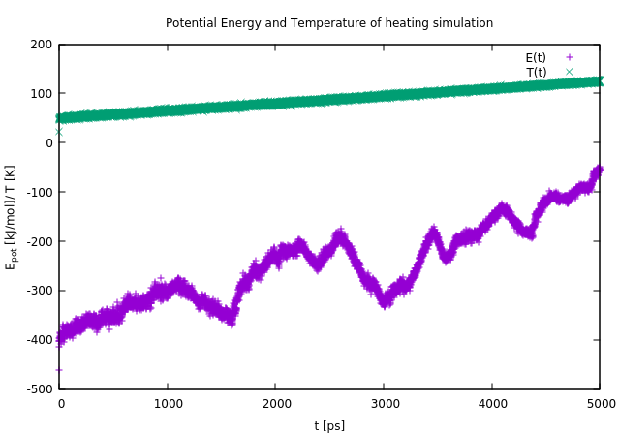
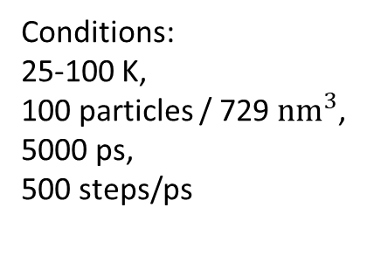
Heating
Conditions:
25-100 K,
100 particles / 729 ${nm}^{3}$,
5000 ps,
500 steps/ps
Fluctuation presumably because of heating to fast, system can not equilibrate, velocities are not „physically“ rescaled according to their trajectory

Slide 13
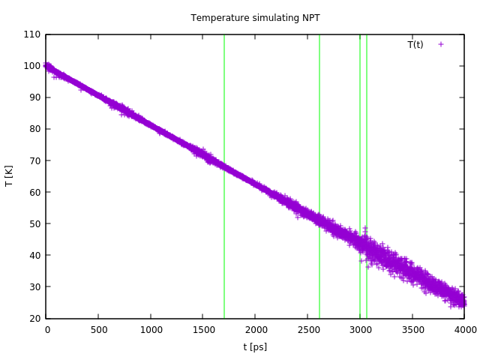
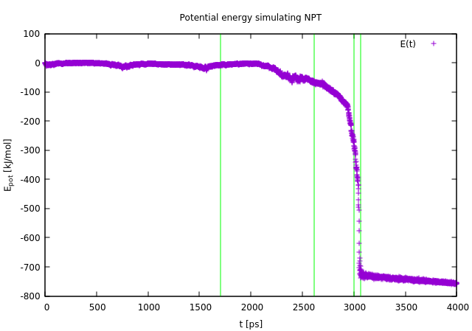
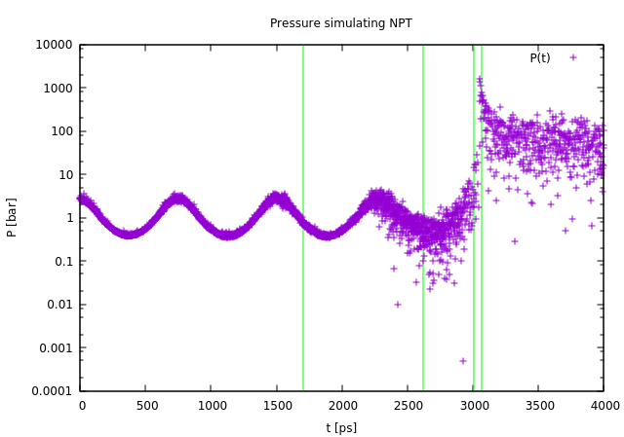
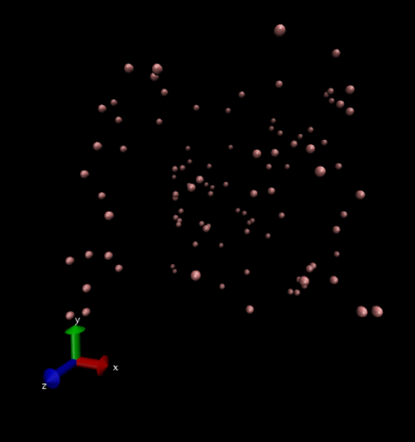
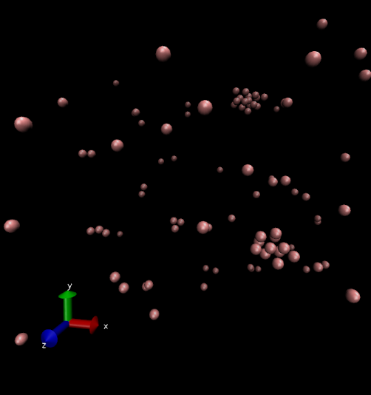
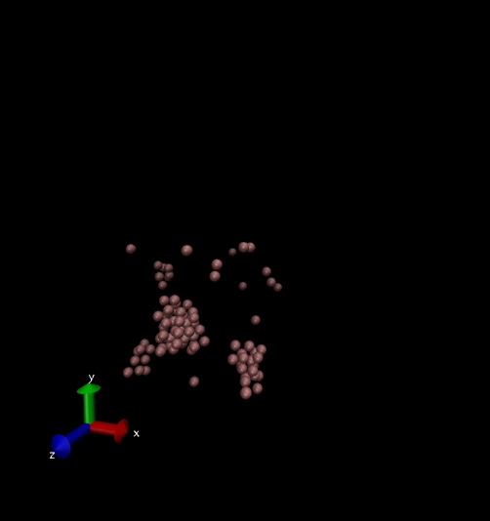
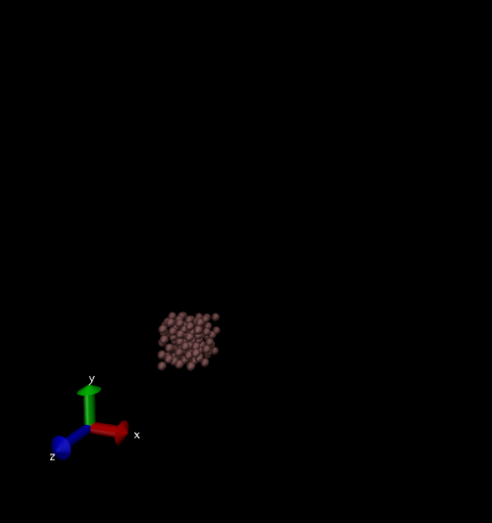
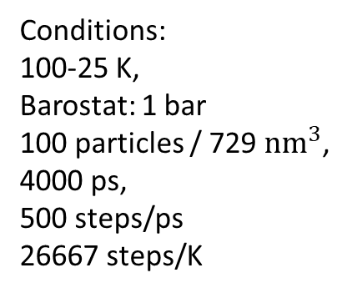
Cooling in NPT
Conditions:
100-25 K,
Barostat: 1 bar
100 particles / 729 ${nm}^{3}$,
4000 ps,
500 steps/ps
26667 steps/K
68 K
51 K
44 K
43 K

Slide 14
Outlook
Longer simulation runs → More time for equilibration
Or
Doing (long) MD runs for the different temperatures separately rather than using annealing
NPT simulations for different pressures to compute a phase diagram that matches the experimental data

Slide 15
Sources
Amber force field: http://ambermd.org/tutorials/basic/tutorial0/
Argon Atom: https://sites.google.com/site/ellesmerealevelchemistry/module-2-foundations-in-chemistry/2-2-electrons-bonding-and-structure/2-2-1-electronic-structure/2-2-1-a-b-c-orbitals-shells-and-sub-shells
Argon Properties: https://en.wikipedia.org/wiki/Argon , and sources therein
Lennard-Jones potential: http://atomsinmotion.com/book/chapter5/md
NVP simulations and argon phase diagram: http://cmb.bio.uni-goettingen.de/pract/p1/
Theoretical background on MD: González, M.A., 2011. Force fields and molecular dynamics simulations. JDN 12, 169–200. https://doi.org/10.1051/sfn/201112009
RDF: https://en.wikipedia.org/wiki/Radial_distribution_function

Slide 16
Supplement I: Material & Methods
Molecular dynamics: Gromacs
Plots: gnuplot
Pictures of simulations: vmd
Movies of simulations: pymol

Slide 17
Supplement II: More movies

